Slide 1
CS4102 Algorithms Fall 2019
Just Kidding!
Come taste-test a cookie!
Nate and I baked cookies for you all this weekend. Start with 2 cookies!
Warm up:
Show that $P=NP$

Slide 2
Today’s Keywords
Reductions
P vs NP
NP Hard, NP Completeness
k-Independent Set
k-Vertex Cover
3SAT
k-Clique

Slide 3
CLRS Readings
Chapter 34

Slide 4
Homeworks
HW9 due Thursday 12/5 at 11pm
Reductions, Graphs
Written (LaTeX)
HW10C due Thursday 12/5 at 11pm
Implement a problem from HW9
No late submissions

Slide 5
Final Exam
Monday, December 9, 7pm in Maury 209 (our section)
Practice exam coming soon
Review session likely the weekend before
SDAC: please schedule for some time on Monday 12/9

Slide 6
Reductions
Algorithm technique of supreme ultimate power
Convert instance of problem A to an instance of Problem B
Convert solution of problem B back to a solution of problem A

Slide 7
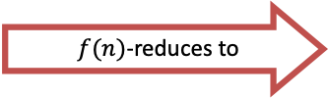
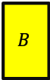
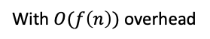
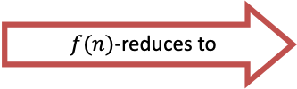

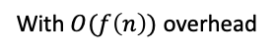
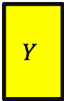



Reductions
Possible uses
Use solver for B to solve A
Prove lower bound for B by showing it’s as hard as A
Don’t know how to solve
$$A$$
$f(n)$-reduces to
$$B$$
Do know how to solve
Problem A
Problem B
$$Y$$
can be used to make
$$X$$
With $O(f\left(n\right))$ overhead
Algorithm for B
Algorithm for A
Problem we know is slow to solve (proved)
$$A$$
$$B$$
Problem we don’t know if slow or fast to solve
$f(n)$-reduces to
Problem A
Problem B
$$Y$$
can be used to make
$$X$$
With $O(f\left(n\right))$ overhead
Algorithm for B
B is no faster than A
Algorithm for A

Slide 8

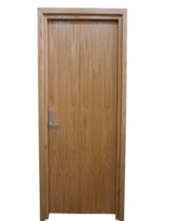
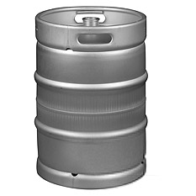

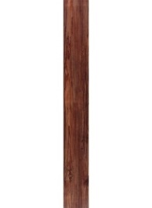

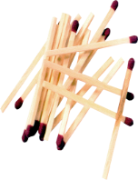

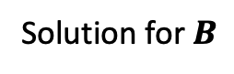
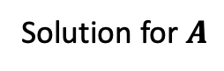

MacGyver’s Reduction
Problem we don’t know how to solve
Problem we do know how to solve
$$A$$
Opening a door
Aim duct at door, insert keg
Lighting a fire
$$B$$
How?
Solution for $A$
Solution for $B$
Keg cannon battering ram
Alcohol, wood, matches
Put fire under the Keg
Reduction

Slide 9
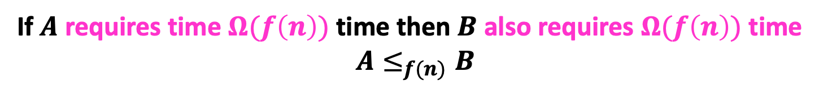
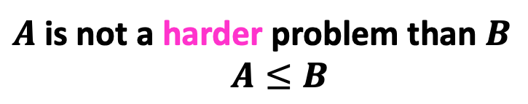


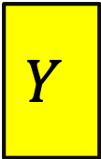


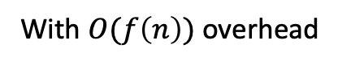
Reduction Proof Notation
$$A$$
$$B$$
$f(n)$-reduces to
Problem B
Problem A
$$Y$$
$$X$$
can be used to make
With $O(f\left(n\right))$ overhead
Algorithm for B
Algorithm for A
$A$ is not a harder problem than $B$
$A≤B$
Or we could have solved A faster using B’s solver!
If $A$ requires time $Ω(f\left(n\right))$ time then $B$ also requires $Ω(f\left(n\right))$ time
$A≤_{f(n)}B$

Slide 10

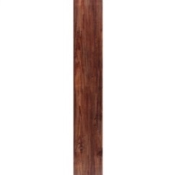
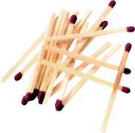


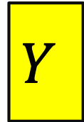
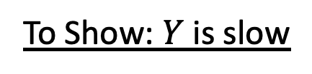

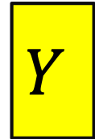

Proof of Lower Bound by Reduction
To Show: $Y$ is slow
$$X$$
1. We know X is slow (by a proof)
(e.g., X = some way to open the door)
$$Y$$
2. Assume Y is quick [toward contradiction]
(Y = some way to light a fire)
$$X$$
$$Y$$
3. Show how to use Y to perform X quickly
4. X is slow, but Y could be used to perform X quickly
conclusion: Y must not actually be quick

Slide 11
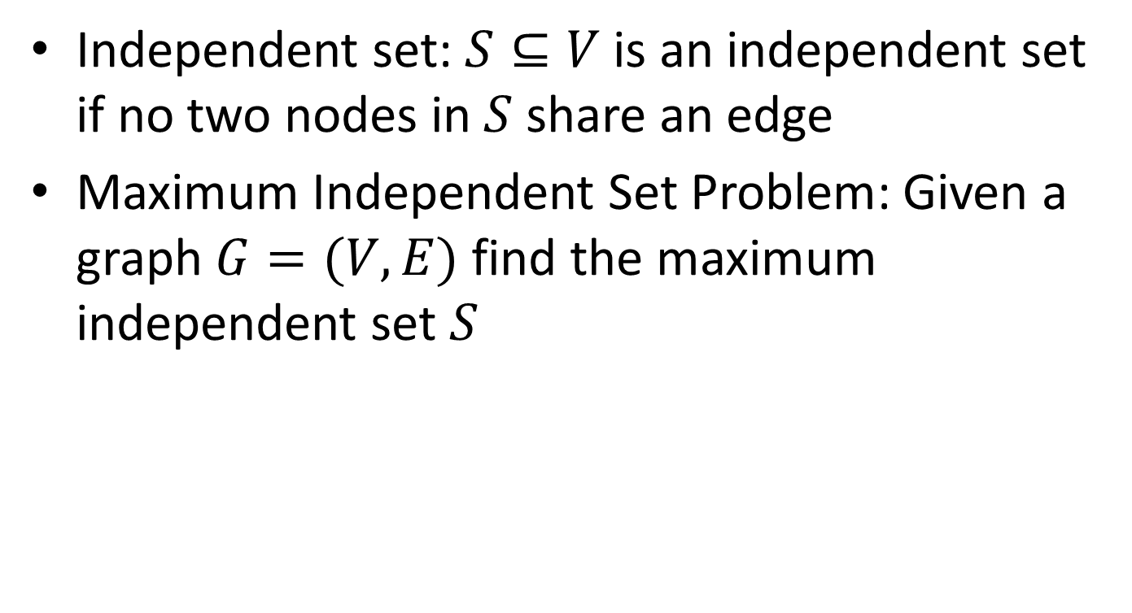
Maximum Independent Set
Independent set: $S⊆V$ is an independent set if no two nodes in $S$ share an edge
Maximum Independent Set Problem: Given a graph $G=(V,E)$ find the maximum independent set $S$

Slide 12
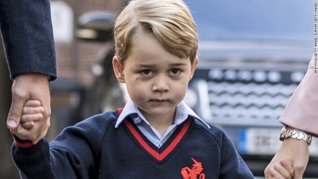


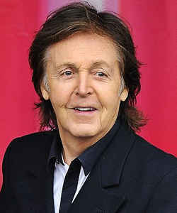
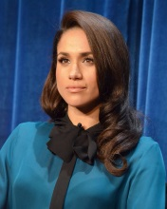
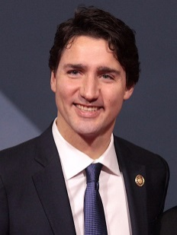
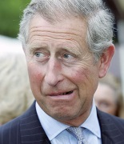
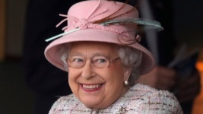



Example
Independent set of size 6

Slide 13
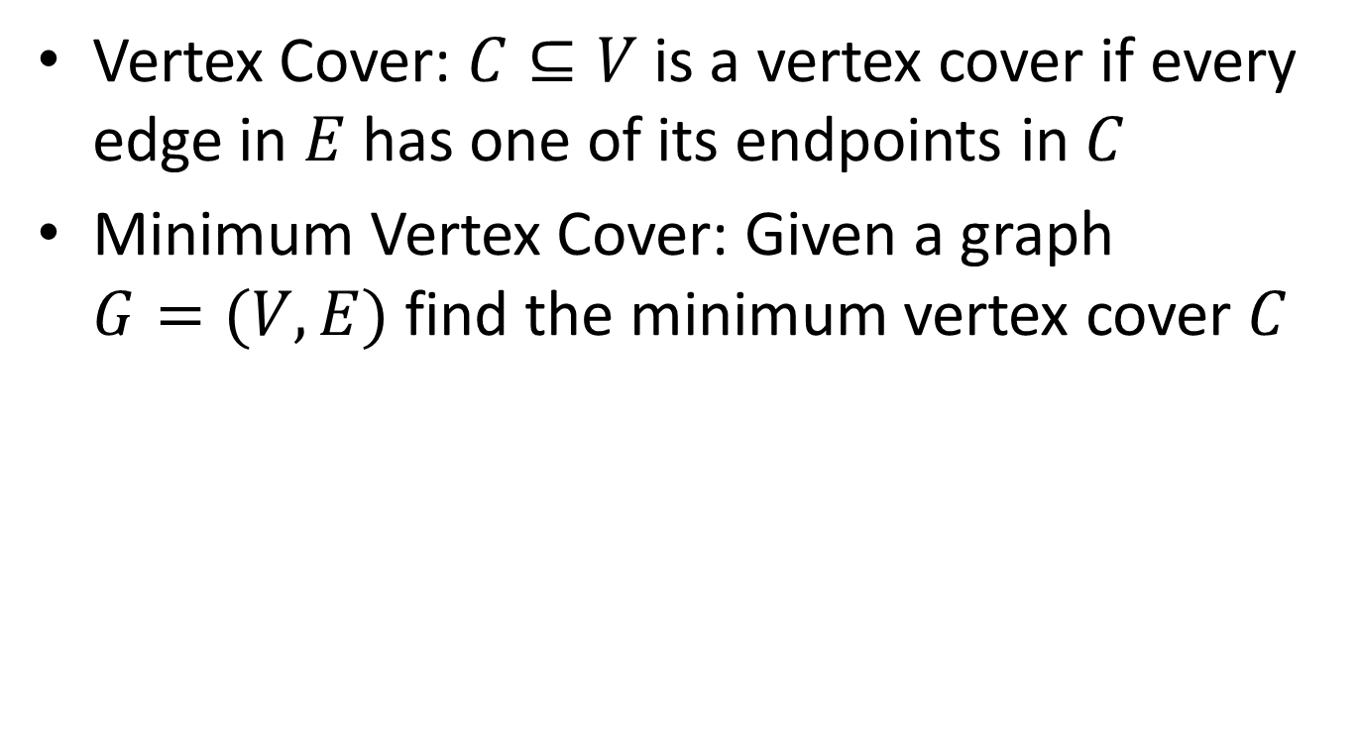
Minimum Vertex Cover
Vertex Cover: $C⊆V$ is a vertex cover if every edge in $E$ has one of its endpoints in $C$
Minimum Vertex Cover: Given a graph $G=(V,E)$ find the minimum vertex cover $C$

Slide 14
Example
Vertex cover of size 5

Slide 15



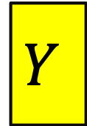

MaxIndSet $V$-Time Reducible to MinVertCover
MaxIndSet
O(V) Time
MinVertCov
$$A$$
$$B$$
Do nothing
Using any Algorithm for MinVertCov
Solution for MaxIndSet
Take complement of solution
Solution for MinVertCov
$$X$$
$$Y$$
Reduction

Slide 16





MaxIndSet $V$-Time Reducible to MinVertCov
MaxIndSet
O(V) Time
MinVertCov
$$A$$
$$B$$
Do nothing
We needed our proof to show that this works!
Using any Algorithm for MinVertCov
Solution for MaxIndSet
Take complement of solution
Solution for MinVertCov
$$X$$
If there was a larger independent set, there would have been a smaller vertex cover!
$$Y$$
Reduction

Slide 17

MinVertCover $V$-Time Reducible to MaxIndSet
MaxIndSet
MinVertCov
O(V) Time
$$A$$
$$B$$
Do nothing
Using any Algorithm for MaxIndSet
Solution for MinVertCov
Take complement of solution
Solution for MaxIndSet
$$X$$
$$Y$$
Reduction

Slide 18
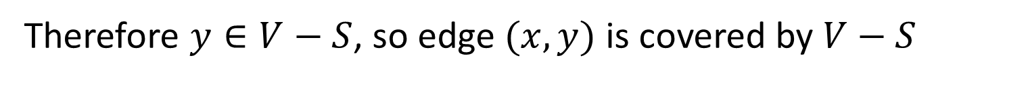

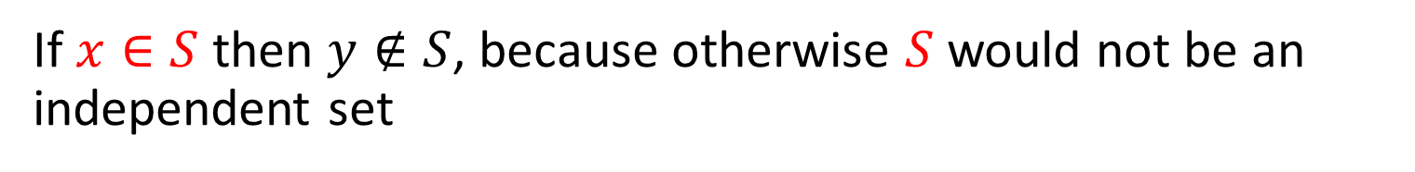
Proof: $⇒$
$S$ is an independent set of $G$ iff $V−S$ is a vertex cover of $G$
Let $S$ be an independent set
Consider any edge $\left(x,y\right)∈E$
If $x∈S$ then $y∉S$, because otherwise $S$ would not be an independent set
Therefore $y∈V−S$, so edge $(x,y)$ is covered by $V−S$

Slide 19
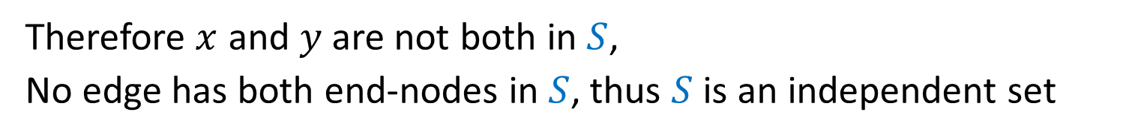

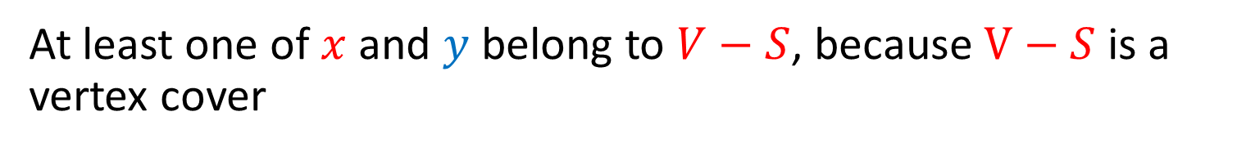
Proof: $⇐$
$S$ is an independent set of $G$ iff $V−S$ is a vertex cover of $G$
Let $V−S$ be a vertex cover
Consider any edge $\left(x,y\right)∈E$
At least one of $x$ and $y$ belong to $V−S$, because $V−S$ is a vertex cover
Therefore $x$ and $y$ are not both in $S$,
No edge has both end-nodes in $S$, thus $S$ is an independent set

Slide 20
Conclusion
MaxIndSet and MinVertCov are either both fast, or both slow
Spoiler alert: We don’t know which!
(But we think they’re both slow)
Both problems are NP-Complete

Slide 21
Why Study NP-Completeness
All semester, we’ve studied finding algorithms to solve problems using various tools.
Sometimes we instead need to prove that a problem is extremely hard, so as not to waste time on it!
NP-Complete Problems are hard
Let’s go over a few of them quickly
Let’s show how to prove a new problem is NP-Complete

Slide 22
Mid-class warm up:
What is a Decision Problem?

Slide 23
Some Preliminaries
Before we go further on this topic….
This is a complex (and interesting!) topic in CS theory
In our few lectures, we may approach things from a simpler viewpoint than you’d get in a CS theory course
The math and theory related to NP-complete problems starts with decision problems
What’s that? Let’s use vertex cover as an example
What’s described next applies to any optimization problems we’ve seen

Slide 24
Max Independent Set
Find the largest set of non-adjacent nodes

Slide 25
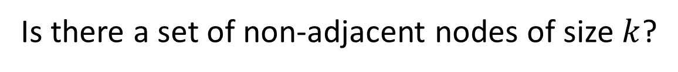

$k$ Independent Set
Is there a set of non-adjacent nodes of size $k$?

Slide 26
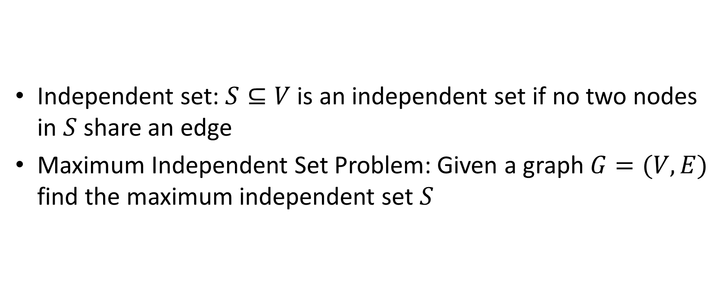
Maximum Independent Set
Independent set: $S⊆V$ is an independent set if no two nodes in $S$ share an edge
Maximum Independent Set Problem: Given a graph $G=(V,E)$ find the maximum independent set $S$

Slide 27
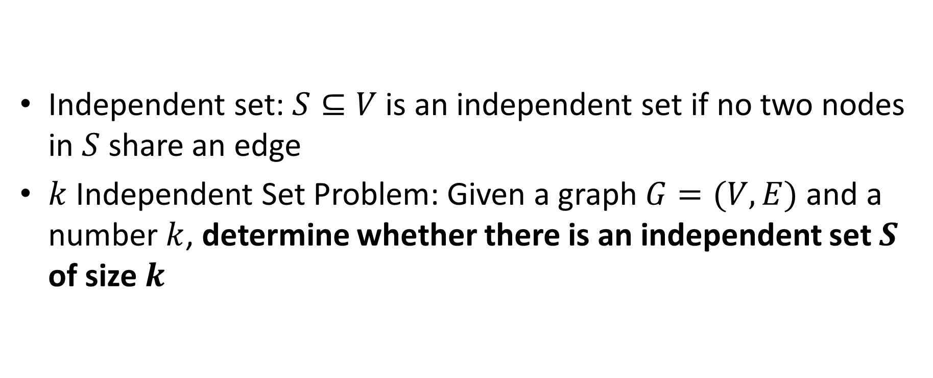
$k$ Independent Set
Independent set: $S⊆V$ is an independent set if no two nodes in $S$ share an edge
$k$ Independent Set Problem: Given a graph $G=(V,E)$ and a number $k$, determine whether there is an independent set $S$ of size $k$

Slide 28
Min Vertex Cover
Find the smallest set of nodes which covers every edge

Slide 29
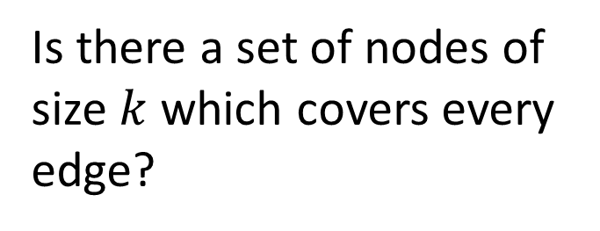

$k$ Vertex Cover
Is there a set of nodes of size $k$ which covers every edge?

Slide 30
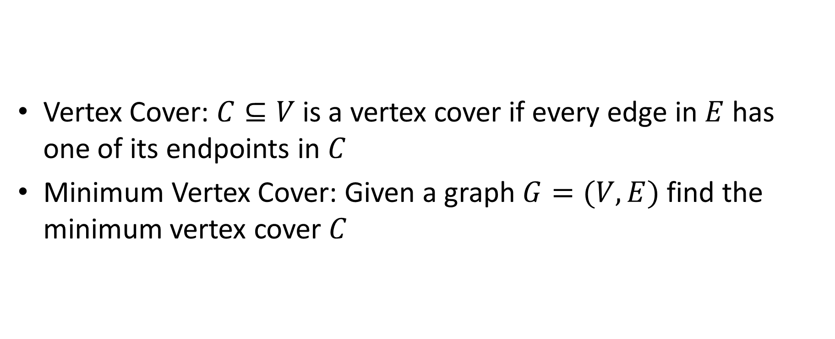
Minimum Vertex Cover
Vertex Cover: $C⊆V$ is a vertex cover if every edge in $E$ has one of its endpoints in $C$
Minimum Vertex Cover: Given a graph $G=(V,E)$ find the minimum vertex cover $C$

Slide 31
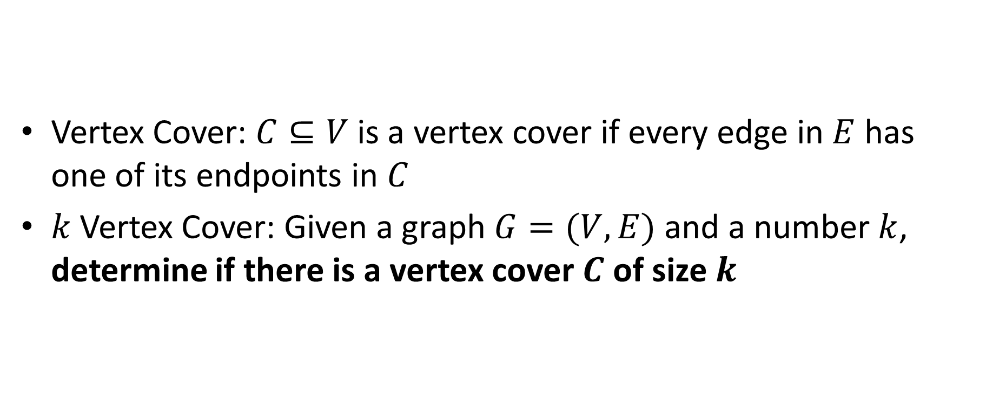
$k$ Vertex Cover
Vertex Cover: $C⊆V$ is a vertex cover if every edge in $E$ has one of its endpoints in $C$
$k$Vertex Cover: Given a graph $G=(V,E)$ and a number $k$, determine if there is a vertex cover $C$ of size $k$

Slide 32
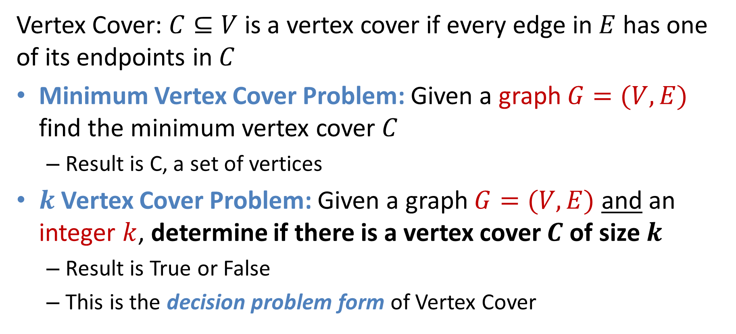
Forms of the Vertex Cover Problem
Vertex Cover: $C⊆V$ is a vertex cover if every edge in $E$ has one of its endpoints in $C$
Minimum Vertex Cover Problem: Given a graph $G=(V,E)$ find the minimum vertex cover $C$
Result is C, a set of vertices
$k$Vertex Cover Problem: Given a graph $G=(V,E)$ and an integer $k$, determine if there is a vertex cover $C$ of size $k$
Result is True or False
This is the decision problem form of Vertex Cover

Slide 33
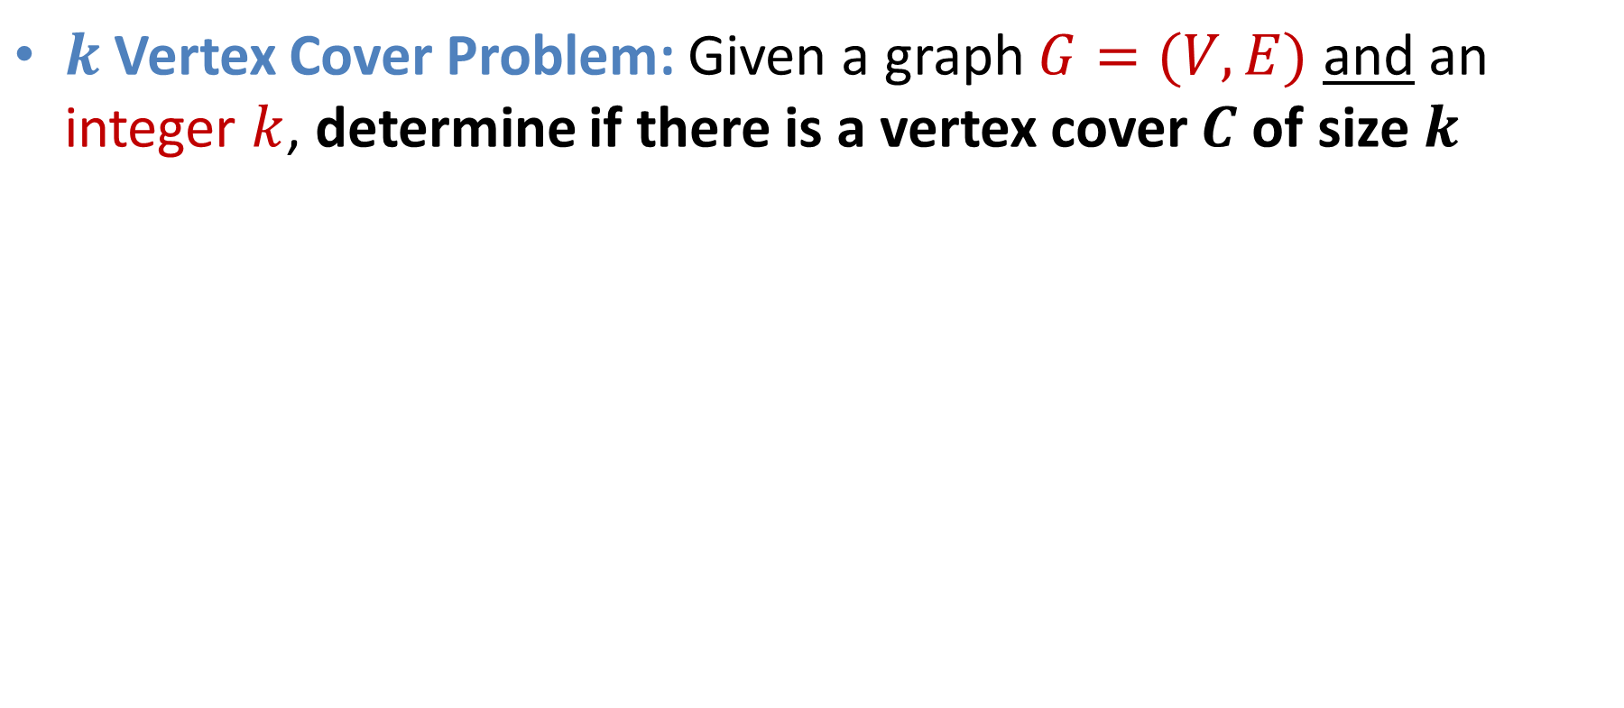
k Vertex Cover
$k$Vertex Cover Problem: Given a graph $G=(V,E)$ and an integer $k$, determine if there is a vertex cover $C$ of size $k$
True for k=6
True for k=5
Is 5 the smallest? True for k=4?

Slide 34
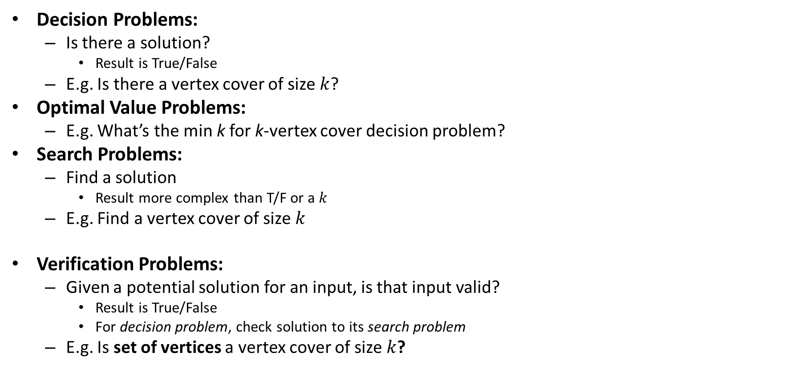
Problem Types
Decision Problems:
Is there a solution?
Result is True/False
E.g. Is there a vertex cover of size $k$?
Optimal Value Problems:
E.g. What’s the min k for k-vertex cover decision problem?
Search Problems:
Find a solution
Result more complex than T/F or a $k$
E.g. Find a vertex cover of size $k$
Verification Problems:
Given a potential solution for an input, is that input valid?
Result is True/False
For decision problem, check solution to its search problem
E.g. Is set of vertices a vertex cover of size $k$?
If we can solve this…
Looking ahead: We’ll use this to define a problem classes P and NP
…Then we can solve this,… …and also this
Looking ahead: We’ll use this to define a problem class called NP

Slide 35
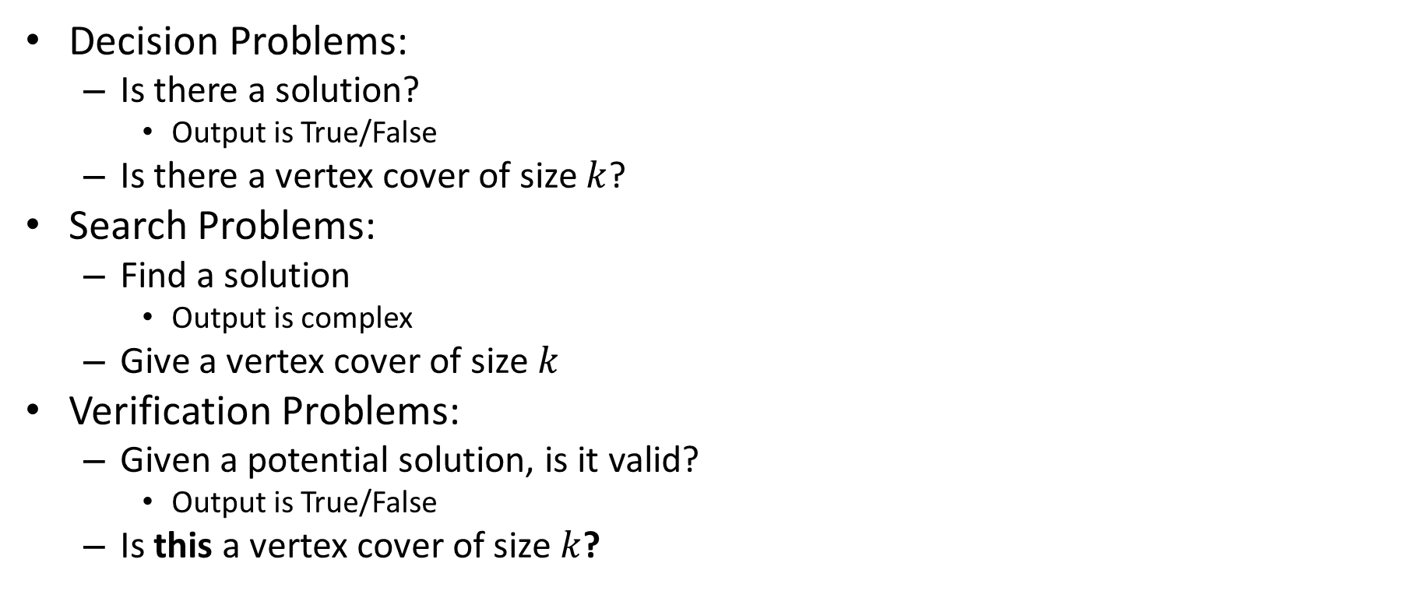
Problem Types
Decision Problems:
Is there a solution?
Output is True/False
Is there a vertex cover of size $k$?
Search Problems:
Find a solution
Output is complex
Give a vertex cover of size $k$
Verification Problems:
Given a potential solution, is it valid?
Output is True/False
Is this a vertex cover of size $k$?
If we can solve this
Then we can solve this

Slide 36
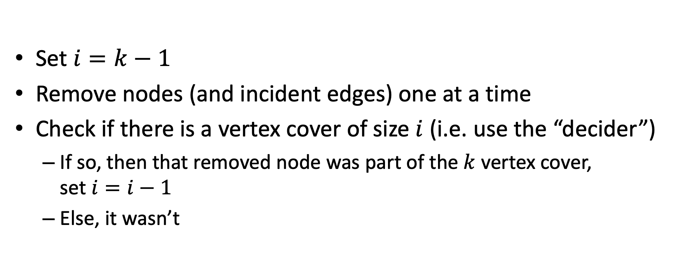
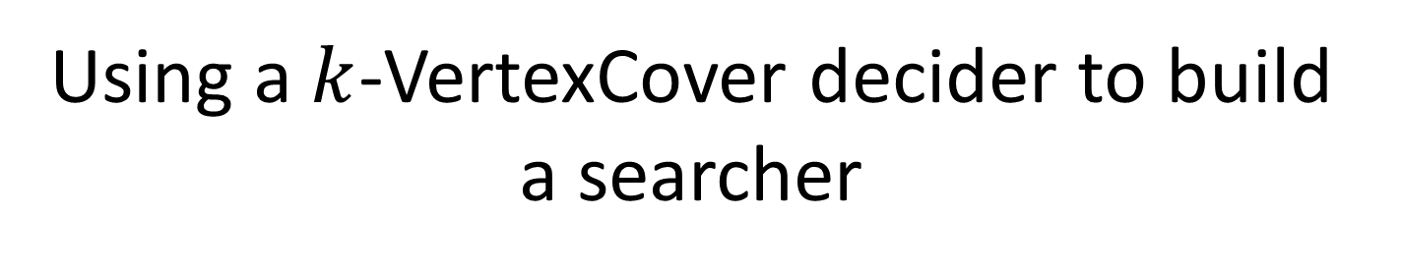
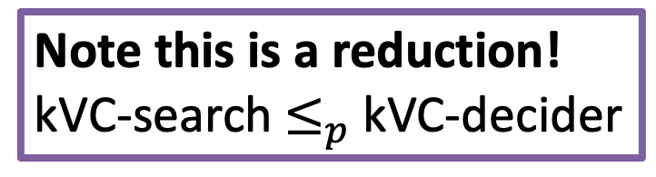
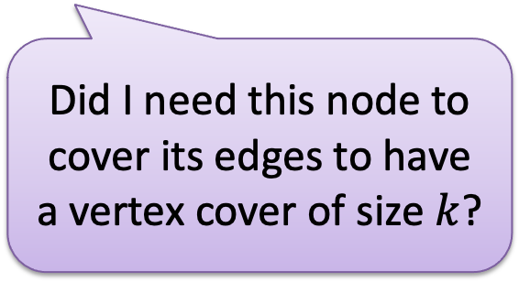
Using a $k$-VertexCover decider to build a searcher
Note this is a reduction! kVC-search$≤_{p}$kVC-decider
Set $i=k−1$
Remove nodes (and incident edges) one at a time
Check if there is a vertex cover of size $i$ (i.e. use the “decider”)
If so, then that removed node was part of the $k$ vertex cover, set $i=i−1$
Else, it wasn’t
Did I need this node to cover its edges to have a vertex cover of size $k$?

Slide 37
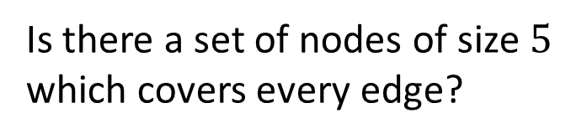

$5$ Vertex Cover (Decision)
Is there a set of nodes of size $5$ which covers every edge?
Yes!

Slide 38
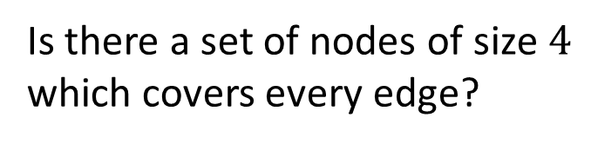

$4$ Vertex Cover (Decision)
Is there a set of nodes of size $4$ which covers every edge?
No!

Slide 39
$4$ Vertex Cover (Decision)
Is there a set of nodes of size $4$ which covers every edge?
Yes!

Slide 40


$3$ Vertex Cover (Decision)
Is there a set of nodes of size $3$ which covers every edge?
No!

Slide 41










Reduction
$k$-VertexCover Solver
$k$-VertexCover Decider
$$A$$
Remove a node, etc…
$$B$$
Using any Algorithm for $B$
Relate Solutions of problem $B$to Solutions of $A$
Solution for $A$
Solution for $B$
$$X$$
$$Y$$
Reduction

Slide 42
Quick Background!
P: Set of problems solved in polynomial time (e.g., sorting a list)
NP: Set of problems that can be:
1) Solved in non-deterministic polynomial time
2) A solution verified in polynomial time
NP-Hard: Set of problems that are as hard as (or harder) than the hardest problems in NP
NP-Complete: Set of problems that are both NP and NP-Hard (i.e., the equally hardest problems in NP)

Slide 43

Classes of Problems: P vs NP
P
Deterministic Polynomial Time
P is the set of problems solvable in polynomial time
$O(n^{c})$ for some number $c$
NP
Non-Deterministic Polynomial Time
NP is the set of problems verifiable in polynomial time
Verify a proposed solution (not find one) in $O(n^{c})$ for some number $c$
For decision problems, really verifying using some information we call a certificate
Open Problem: Does P=NP?
Certainly $P⊆NP$
NP
P

Slide 44



$k$-Independent Set is NP
To show: Given a potential solution, can we verify it in $O(n^{p})$? $[n=V+E]$
How can we verify it?
Check that it’s of size $k$ $O(V)$
Check that it’s an independent set $O(V^{2})$

Slide 45


$k$-Vertex Cover is NP
To show: Given a potential solution, can we verify it in $O(n^{p})$? $[n=V+E]$
How can we verify it?
Check that it’s of size $k$ $O(V)$
Check that it’s a Vertex Cover $O(E)$

Slide 46

NP-Hard
How can we try to figure out if P=NP?
Identify problems at least as “hard” as NP
If any of these “hard” problems can be solved in polynomial time, then all NP problems can be solved in polynomial time.
Definition: NP-Hard:
$B$ is NP-Hard if $∀A∈NP, A≤_{p}B$
$A≤_{p}B$ means $A$ reduces to $B$ in polynomial time
Remember: $A≤_{p}B$implies $A$ is not harder than $B$
NP-H
At least as “hard” as NP
NP
P

Slide 47







NP-Hardness Reduction
Any NP-Hard Problem
$$O(n^{p})$$
Problem to show is NP-Hard
$$A$$
$$B$$
Then this could be solved in polynomial time
If This could be solved in Polynomial time
Solution for $A$
Solution for $B$
$$X$$
$$Y$$
$$A≤_{p}B$$
Reduction

Slide 48

NP-Complete
NP-Complete = NP $∩$ NP-Hard
The “hardest” of all the problems in NP
An NP-C problem is polynomial iff all NP problems are polynomial. I.e. P=NP
If P=NP, then all NP-C problems are polynomial
“Together they stand, together they fall”
How to show a problem $C$ is NP-Complete?
Show $C$ belongs to NP
Show we can verify a solution in polynomial time
Show $C$ is NP-Hard
$∀A∈NP, A≤_{p}C$ (That sounds really hard to do!)
Or, show a reduction from another NP-Hard problem. (Why? Details next.)
NP-H
At least as “hard” as NP
NP-C
NP
P
We now just need a FIRST NP-Hard problem

Slide 49

NP-Completeness
So…a problem is NP-Complete if you can do the following:
1) Show how to verify it in polynomial time
Given a solution to the problem, verify it is correct
That algorithm’s runtime needs to be a polynomial (usually easy)
2) Show the problem is NP-Hard (as hard or harder than a known NP-Hard Problem)
Take a currently known NP-Hard problem (let’s call it A)
Show that $A≤_{p}X$ (where X is your problem)
Why? If $A$ is NP-Hard, then: any NP problem $≤_{p}A$
Transitivity: any NP problem $≤_{p}A$ $≤_{p}X$
So $X$ satisfies definition of NP-Hard

Slide 50
“Consequences” of NP-Completeness
NP-Complete is the set of “hardest” problems in NP, with these important properties:
If any one NP-Complete problem can be solved in polynomial time…
…then every NP-Complete problem can be solved in polynomial time…
…and in fact every problem in NP can be solved in polynomial time (which would show P = NP)
Or, prove an exponential lower-bound for any single NP-hard problem, then every NP-hard problem (including NP-C) is exponential
Therefore: solve (say) traveling salesperson problem in O(n¹⁰⁰) time, you've proved that P = NP. Retire rich & famous!

Slide 51

NP-Completeness: $A≤_{p}B$ and B in P
Any NP-Complete Problem
$$O(n^{p})$$
Any other NP-Complete Problem
$$A$$
$$B$$
Then this could be done in polynomial time
If This could be done in polynomial time
Solution for $A$
Solution for $B$
$$X$$
$$Y$$
Reduction

Slide 52

NP-C: $A≤_{p}B$ and we prove A not in P
Any NP-Complete Problem
$$O(n^{p})$$
Any other NP-Complete Problem
$$A$$
$$B$$
If this cannot be done in polynomial time
Then this cannot be done in polynomial time
Solution for $A$
Solution for $B$
$$X$$
$$Y$$
Reduction

Slide 53
Summary of Where We Are
Focusing on “hard” problems, those that seem to be exponential
Reductions used to show “hardness” relationships between problems
Starting to define “classes” of problems based on complexity issues
P are problems that can be solved in polynomial time
NP are problems where a solution can be verified in polynomial time
NP-hard are problems that are at least as hard as anything in NP
NP-complete are NP-hard problems that “stand or fall together”

Slide 54
Review: P And NP Summary
P = set of problems that can be solved in polynomial time
NP = set of problems for which a solution can be verified in polynomial time
Note: this is a more “informal” definition, but it’s fine for CS4102
See later slide on ”certificates” for more info.
P ⊆ NP
Open question: Does P = NP?

Slide 55
More Reminders and Some Consequences
Definition of NP-Hard and NP-Complete:
If all problems A ∈ NP are reducible to B , then B is NP-Hard
We say B is NP-Complete if:
B is NP-Hard
and B ∈ NP
Any NP-C must reduce to any other NP-C. Can you see why?
If B ≤_{p} C and B is NP-Complete, C is also NP-Complete
Don’t see why? We’ll show details in two more slides
As long as C ∈ NP. Otherwise can only say C ∈ NP-hard.

Slide 56

3-SAT
Shown to be NP-Hard by Cook and Levin (independently)
Given a 3-CNF formula (logical AND of clauses, each an OR of 3 variables), Is there an assignment of true/false to each variable to make the formula true?
$$\left(x∨y∨z\right)∧\left(x∨\overline{y}∨y\right)∧\left(u∨y∨\overline{z}\right)∧\left(z∨\overline{x}∨u\right)∧(\overline{x}∨\overline{y}∨\overline{z})$$
Clause
$$x=true$$
$$y=false$$
$$z=false$$
$$u=true$$
Variables

Slide 57
Conjunctive Normal Form (CNF)
Even if the form of the Boolean expression is simplified, the problem may be NP-Complete
Literal: an occurrence of a Boolean or its negation
A Boolean formula is in conjunctive normal form, or CNF, if it is an AND of clauses, each of which is an OR of literals
Ex: (x₁ ∨ ¬x₂) ∧ (¬x₁ ∨ x₃ ∨ x₄) ∧ (¬x₅)
3-CNF: each clause has exactly 3 distinct literals
Ex: (x₁ ∨ ¬x₂ ∨ ¬x₃) ∧ (¬x₁ ∨ x₃ ∨ x₄) ∧ (¬x₅ ∨ x₃ ∨ x₄)
Notice: true if at least one literal in each clause is true
Note: Arbitrary SAT expressions can be translated into CNF forms by introducing intermediate variables etc.

Slide 58
Joining the Club
Given one NP-Complete problem, others can join the club
Prove that SAT reduces to another problem, and so on…
Membership in NP-Complete grows…
Classic textbook: Garey, M. and D. Johnson, Computers and Intractability: A Guide to the Theory of NP-Completeness, 1979.
SAT
3-CNF-SAT
SUBSET-SUM
CLIQUE
VERTEX- COVER
HAM- CYCLE
TSP

Slide 59


$k$-Independent Set is NP-Complete
Show that it belongs to NP
Give a polynomial time verifier
Show it is NP-Hard
Give a reduction from a known NP-Hard problem
Show $3SAT≤_{p}kIndSet$

Slide 60



Remember: $k$-Independent Set is NP
To show: Given a certificate (“solution” for the search problem), can we verify it in $O(n^{p})$? $[n=V+E]$
How can we verify it?
Check that it’s of size $k$ $O(V)$
Check that it’s an independent set $O(V^{2})$

Slide 61
$k$-Independent Set is NP-Complete
Show that it belongs to NP
Give a polynomial time verifier
Show it is NP-Hard
Give a reduction from a known NP-Hard problem
Show $3SAT≤_{p}kIndSet$

Slide 62



$$3SAT≤_{p}kIndSet$$
3SAT
$$O(n^{p})$$
$k$-Ind Set
$$A$$
$$B$$
Solution for 3SAT
Solution for $k$-Ind Set
$$X$$
$$Y$$
Reduction

Slide 63
















Instance of 3SAT to Instance of $k$IndSet
$$\left(x∨y∨z\right)∧\left(x∨\overline{y}∨y\right)∧\left(u∨y∨\overline{z}\right)∧\left(z∨\overline{x}∨u\right)∧(\overline{x}∨\overline{y}∨\overline{z})$$
$$x$$
$$u$$
$$z$$
$$\overline{u}$$
$$x$$
$$y$$
$$\overline{y}$$
$$\overline{z}$$
$$y$$
$$u$$
$$\overline{x}$$
$$\overline{z}$$
$$\overline{y}$$
$$z$$
$$y$$
For each clause, produce a triangle graph with its three variables as nodes
Connect each node to all of its opposites
Let $k=$ number of clauses
There is a $k$-IndSet in this graph iff there is a satisfying assignment

Slide 64







$k$IndSet $⇒$ Satisfying Assignment
$$\left(x∨y∨z\right)∧\left(x∨\overline{y}∨y\right)∧\left(u∨y∨\overline{z}\right)∧\left(z∨\overline{x}∨u\right)∧(\overline{x}∨\overline{y}∨\overline{z})$$
$$z$$
$$x=true$$
$$y=false$$
$$z=false$$
$$u=true$$
$$x$$
$$x$$
$$u$$
$$\overline{u}$$
$$y$$
$$\overline{y}$$
$$\overline{z}$$
$$y$$
$$u$$
$$\overline{x}$$
$$\overline{z}$$
$$\overline{y}$$
$$z$$
$$y$$
One node per triangle is in the Independent set:
because we can have exactly $k$ total in the set, and 2 in a triangle would be adjacent
If $x$ is selected in some triangle, $\overline{x}$ is not selected in any triangle:
Because every $x$ is adjacent to every $\overline{x}$
Set the variable which each included node represents to “true”

Slide 65


Satisfying Assignment $⇒k$IndSet
$$\left(x∨y∨z\right)∧\left(x∨\overline{y}∨y\right)∧\left(u∨y∨\overline{z}\right)∧\left(z∨\overline{x}∨u\right)∧(\overline{x}∨\overline{y}∨\overline{z})$$
$$x$$
$$z$$
$$x=true$$
$$y=false$$
$$z=false$$
$$u=true$$
$$x$$
$$u$$
$$\overline{u}$$
$$y$$
$$\overline{y}$$
$$\overline{z}$$
$$y$$
$$u$$
$$\overline{x}$$
$$\overline{z}$$
$$\overline{y}$$
$$z$$
$$y$$
Use one true variable from the assignment for each triangle
The independent set has $k$ nodes, because there are $k$ clauses
If any variable $x$ is true then $\overline{x}$ cannot be true

Slide 66









3-SAT $≤_{p}$ $k$-Independent Set
3-SAT
$k$-independent set
Map instances of problem $A$to instances of $B$
polynomial time
$$k=3$$
Map solutions of problem $B$to solutions of $A$
$$x=true$$
$$y=false$$
$$z=false$$
$$u=true$$
polynomial time
$$k=3$$
polynomial-time reduction

Slide 67

$$3SAT≤_{p}kIndSet$$
3SAT
$$O(n^{p})$$
$k$-Ind Set
$$A$$
$$B$$
Make triangles, connect opposites, $k=$ num clauses
Then This could be done in polynomial time
If This could be done in Polynomial time
Solution for 3SAT
Assign true to variables from selected nodes
Solution for $k$-Ind Set
$$X$$
$$Y$$
Reduction

Slide 68


$k$-Vertex Cover is NP-Complete
Show that it belongs to NP
Give a polynomial time verifier
Show it is NP-Hard
Give a reduction from a known NP-Hard problem
We showed $kIndSet≤_{p}kVertCov$

Slide 69


Remember: $k$-Vertex Cover is NP
To show: Given a certificate (“solution” for the search problem), can we verify it in $O(n^{p})$? $[n=V+E]$
How can we verify it?
Check that it’s of size $k$ $O(V)$
Check that it’s a Vertex Cover $O(E)$

Slide 70
$k$-Vertex Cover is NP-Complete
Show that it belongs to NP
Give a polynomial time verifier
Show it is NP-Hard
Give a reduction from a known NP-Hard problem
We showed $kIndSet≤_{p}kVertCov$

Slide 71






Remember: $kIndSet≤_{p}kVertCov$
$$kIndSet$$
$$O(n^{p})$$
$$kVertCov$$
$$A$$
$$B$$
$$k=V−k$$
Then This could be done in polynomial time
If This could be done in Polynomial time
Solution for $kIndSet$
Take Complement of nodes
Solution for $kVertCov$
$$X$$
$$Y$$
Reduction

Slide 72


$k$-Clique Problem
Given a graph $G$ and a number $k$, is there a clique of size $k$?
Clique: A complete subgraph
4-Clique
3-Clique

Slide 73


$k$-Clique is NP-Complete
Show that it belongs to NP
Give a polynomial time verifier
Show it is NP-Hard
Give a reduction from a known NP-Hard problem
We will show $3SAT≤_{p}kClique$

Slide 74


$k$-Clique is NP
Given a Graph, $k$, and a certificate (“solution” for the search problem)
Check that the solution has $k$ nodes
Check that every pair of nodes share an edge
4-Clique
3-Clique

Slide 75








$k$-Clique is in NP
Show: For any graph $G$:
There is a short certificate (“solution”) that $G$ has a $k$-clique
The certificate can be checked efficiently (in polynomial time)
Suppose $k=4$
C
Certificate for $G$: $S=\left\{B,D,E,F\right\}$
(nodes in the $k$-clique)
Checking the certificate:
Check that $\left|S\right|=k$
Check that every pair of nodes in $S$ share an edge
B
4-Clique
A
E
D
F
$$O\left(k\right)=O\left(\left|V\right|\right)$$
G
I
3-Clique
$$O\left(k^{2}\right)=O({\left|V\right|}^{2})$$
H
Graph $G$
Total time: $O\left({\left|V\right|}^{2}\right)=poly\left(\left|V\right|+\left|E\right|\right)$

Slide 76





$$3SAT≤_{p}kClique$$
$$3SAT$$
$$O(n^{p})$$
$$kClique$$
$$A$$
$$B$$
Solution for $3SAT$
Solution for $kClique$
$$X$$
$$Y$$
Reduction

Slide 77
















Instance of 3SAT to Instance of $k$Clique
$$\left(x∨y∨z\right)∧\left(x∨\overline{y}∨y\right)∧\left(u∨y∨\overline{z}\right)∧\left(z∨\overline{x}∨u\right)∧(\overline{x}∨\overline{y}∨\overline{z})$$
$$x$$
$$y$$
$$\overline{y}$$
$$u$$
$$z$$
$$x$$
$$\overline{x}$$
(also do this for the other clauses, omitted due to clutter)
$$z$$
$$y$$
$$\overline{y}$$
$$\overline{u}$$
$$y$$
$$\overline{z}$$
$$u$$
$$\overline{z}$$
For each clause, produce a node for each of its three variables
Connect each node to all non-contradictory nodes in the other clauses
(i.e., anything that’s not its negation)
Let $k=$ number of clauses
There is a $k$-Clique in this graph iff there is a satisfying assignment

Slide 78








$k$Clique $⇒$ Satisfying Assignment
$$\left(x∨y∨z\right)∧\left(x∨\overline{y}∨y\right)∧\left(u∨y∨\overline{z}\right)∧\left(z∨\overline{x}∨u\right)∧(\overline{x}∨\overline{y}∨\overline{z})$$
$$x=true$$
$$y=false$$
$$z=false$$
$$u=true$$
$$x$$
$$y$$
$$\overline{y}$$
$$u$$
$$z$$
$$x$$
$$\overline{x}$$
$$z$$
$$y$$
$$\overline{y}$$
$$\overline{u}$$
$$y$$
$$\overline{z}$$
$$u$$
$$\overline{z}$$
There are $k$ triplets in the graph, and no two nodes in the same triplet are adjacent
To have a $k$-Clique, must have one node from each triplet
Cannot select a node for both a variable and its negation
Therefore selection of nodes is a satisfying assignment

Slide 79













Satisfying Assignment$⇒$ $k$Clique
$$\left(x∨y∨z\right)∧\left(x∨\overline{y}∨y\right)∧\left(u∨y∨\overline{z}\right)∧\left(z∨\overline{x}∨u\right)∧(\overline{x}∨\overline{y}∨\overline{z})$$
$$x=true$$
$$y=false$$
$$z=false$$
$$u=true$$
$$x$$
$$y$$
$$\overline{y}$$
$$u$$
$$z$$
$$x$$
$$\overline{x}$$
$$z$$
$$y$$
$$\overline{y}$$
$$\overline{u}$$
$$y$$
$$\overline{z}$$
$$u$$
$$\overline{z}$$
Select one node for a true variable from each clause
There will be $k$ nodes selected
We can’t select both a node and its negation
All nodes will be non-contradictory, so they will be pairwise adjacent

Slide 80

$$3SAT≤_{p}kClique$$
$$3SAT$$
$$O(n^{p})$$
$$kClique$$
$$A$$
Make a triplet per clause, connect non-contraditcory nodes among clauses
$$B$$
Then This could be done in polynomial time
If This could be done in Polynomial time
Solution for $3SAT$
Assign each variable selected to True
Solution for$kClique$
$$X$$
$$Y$$
Reduction

